Slide 1
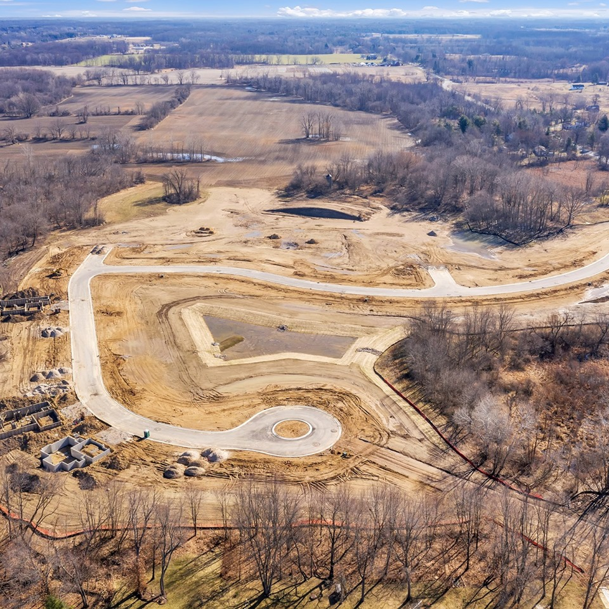

Brownfield Housing Incentive
Presented by
Amber Clark
Neighborhoods & Economic Development Director
Date:
March 2025
Notes:
Welcome back Board members. In May of 2024 we discussed the States updates to Brownfield Reimbursement.

Slide 2
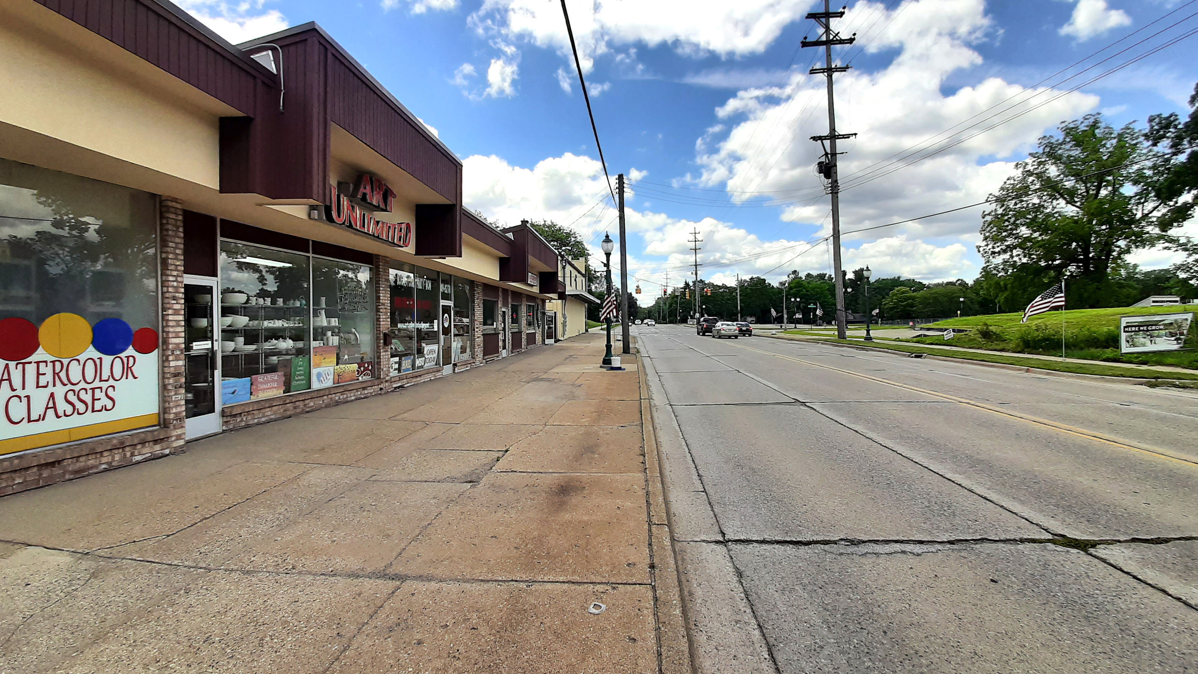
What is a Brownfield Site?
# 1
An urban site for potential development, having had previous development where it is contaminated from that previous use or is perceived to be contaminated.
Definition:
# 2
Previously developed land that has been abandoned, underutilized, and which may carry pollution, or a risk of pollution from the previous use.
Notes:
As stated previously, Brownfield Work/Combined Work plans through EGLE or MEDC/MSF will function the exact same as they have before.

Slide 3


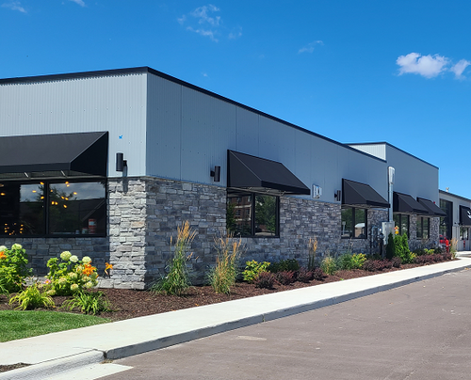
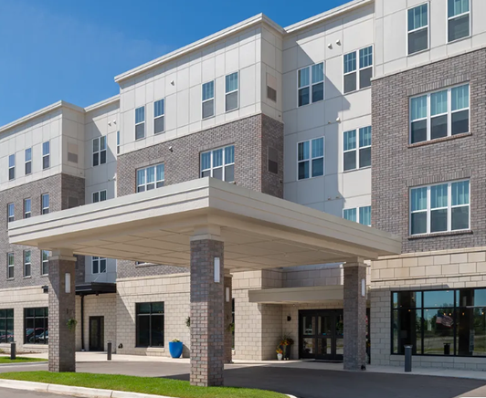
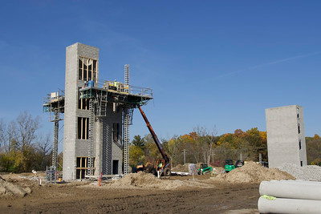
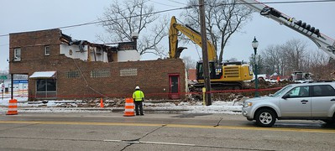
A traditional financial institution (bank) will require a developer to have access to equity at 25% or more of the total project cost. The costs to “clean up” a site are not costs that the developer typically can pass on to tenants as the clean up generally should occur with or prior to construction. These additional costs can make a project hard to finance.
Developers may be able to get access to funding from a financial institution with an approved Brownfield plan defining when and how much will be reimbursed. This can close the gap in funding and help a project proceed.
Function of Brownfield TIF
Plan Duration
$$$ Future Value
$$ Base Year

Slide 4
How is it Defined?
PA 381 :
Authorization to create Brownfield Authorities, districts/ zones, facilitation of plans, to redevelop properties that contain/contained blighted, functionally obsolete property or any other “eligible activity”.
1996
PA 90 :
Authorization to allow Brownfield Plans to include the use of taxes levied for school operation purposes with the State of Michigan as eligible reimbursement housing development activities for affordable (under 120% AMI) housing units.
2023
Notes:
Explain that previously the site was only eligible for BRA reimbursement at the local or state level by meeting the traditional definitions(Functionally obsolete, asbestos, contamination, blighted)
New definition, to access STATE School Operating taxes, the project must include a housing component that will support incomes of 120% AMI or less.
As stated previously, Brownfield Work/Combined Work plans through EGLE or MEDC/MSF will function the exact same as they have before.
To access the additional funding in SET, the site must qualify with housing affordability components.

Slide 5

MSHDA Updates
Plan Submissions:
9 Work Plans formally submitted
Approvals:
9 Work Plans conditionally approved
Average Tax Capture: 23 Years
Average Unit Count: 78 Units
Average Reimbursement: $7M

Slide 6
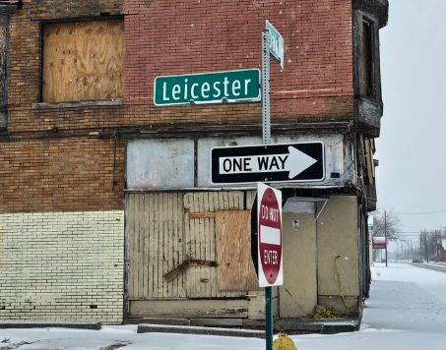
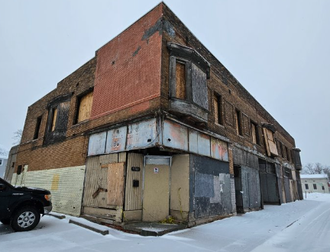
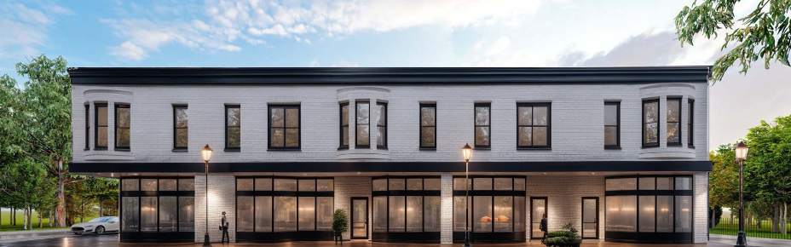
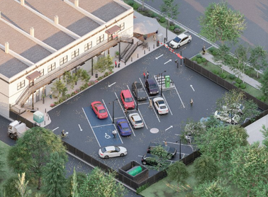
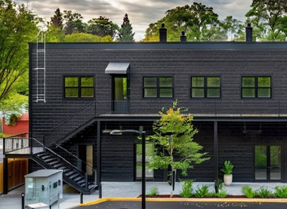
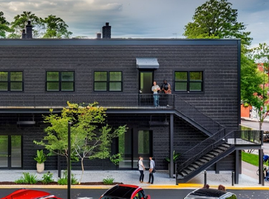
Michigan State Housing Development Authority MSHDA Projects
Detroit’s North End
Vacant and blighted hundred-year-old building located at 9301 Oakland Avenue will be redeveloped into 10 residential units and 5,200 square feet of commercial space, enhancing walkability and connectivity to the neighboring commercial corridor.
PA 210 Tax Abatement =$249,959 from the City of Detroit
$75,000 grant = DECGs Motor City Match Program
$91,000 grant=City of Detroit Housing & Revitalization Department’s ASA Accessibility Program.
Wayne County = $14,840
Michigan State Housing Development Authority Missing Middle grant valued at $800,000
15 Year abatement
$1,230,799 total Grant Incentives

Slide 7
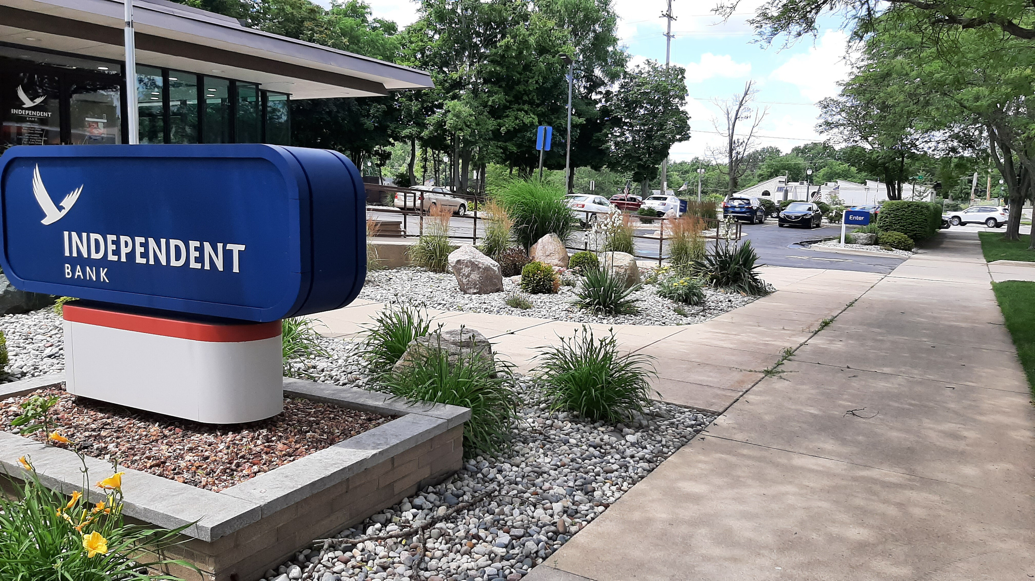

PA 381 of 1996
In 1996 State of Michigan legislators adopted PA 381 to allow municipalities to create Brownfield Redevelopment Authorities. As a commission, the BRA body has the ability to use Tax Increment Financing as a tool for redevelopment.
Municipalities after establishing their Brownfield Authority and TIF plan are then able to partner with private property owners to assist them with the redevelopment of their site with the use of Brownfield incentives. Incentives can be grants, loans, and approved TIF plans. Incentives may include local only or local + State tax incentives.
Once the Plan is approved, the property owner/developers are then able to conduct the necessary work to remediate the site. Once the work is complete, a full list of activities conducted, costs, and amounts of remediation are reviewed. Reimbursements are approved for authorized eligible costs that support the overall remediation plan.

Slide 8
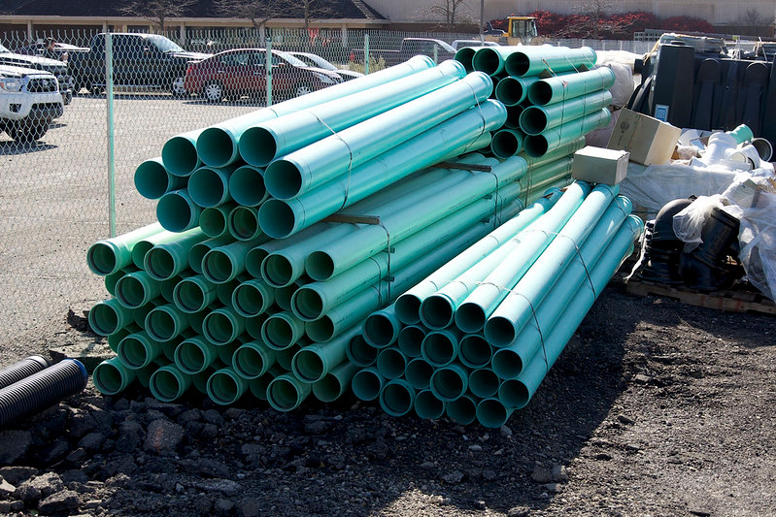
PA 90 of 2024
In 2023 State of Michigan legislators adopted PA 90 to allow a development to access School Operation Education Tax (SET) if the project supports the development of housing units at 120% of the area median income or less. With an approval by the local unit of government Brownfield Authority, an application for the use of SET to fill gaps in housing developments may be approved by the Michigan State Housing Development Authority.
A developer committed to creating affordable housing units will provide a proforma indicating income generated and expenses to construct the project. This recent legislation change only amends the definition of what can be included as an eligible cost.
Participation in this incentive comes with a request from the Local BRA to MSHDA include the use of SET for eligible housing activities. If approved the plan will determine the number of units, unit type, gap or rent loss calculation and plan duration. The total amount of TIF Capture that a MSHDA‐approved housing development will be eligible to utilize will NOT be greater than the amount of TIF generated over the life of the plan.

Slide 9
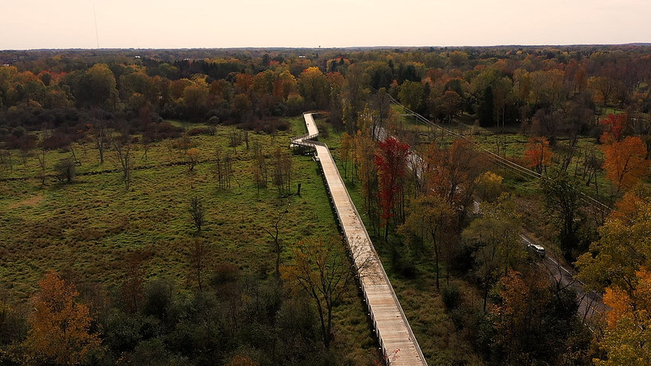

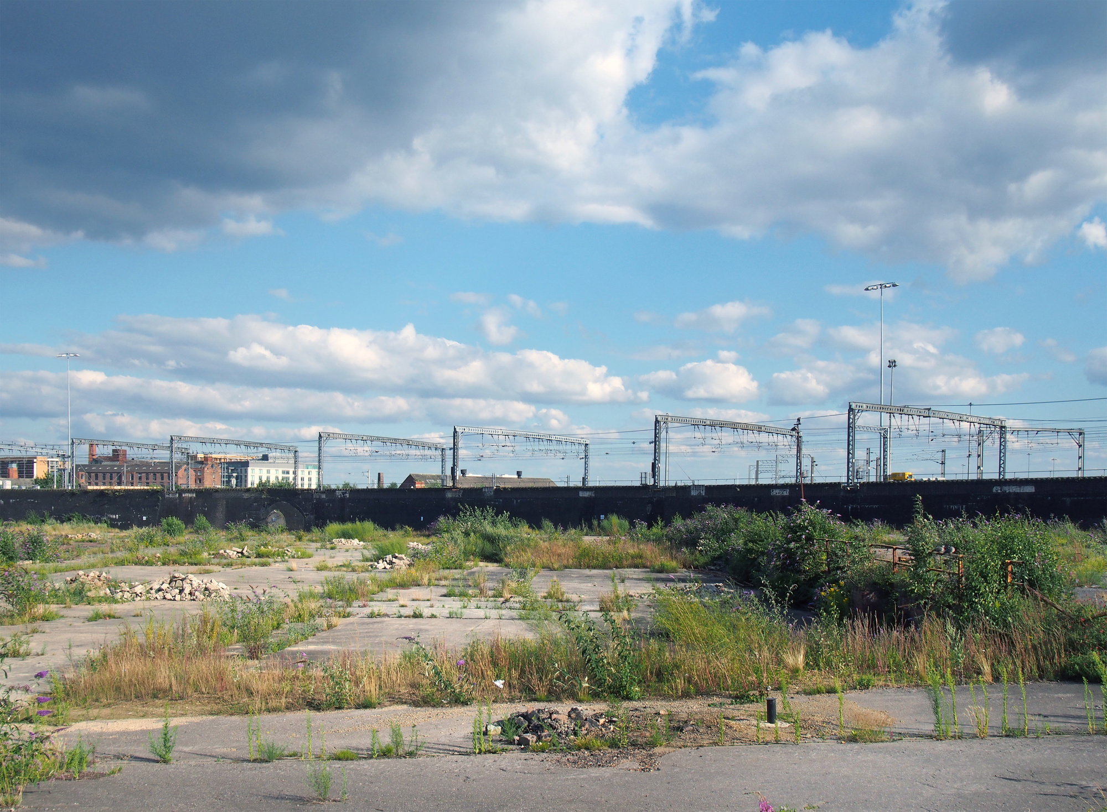
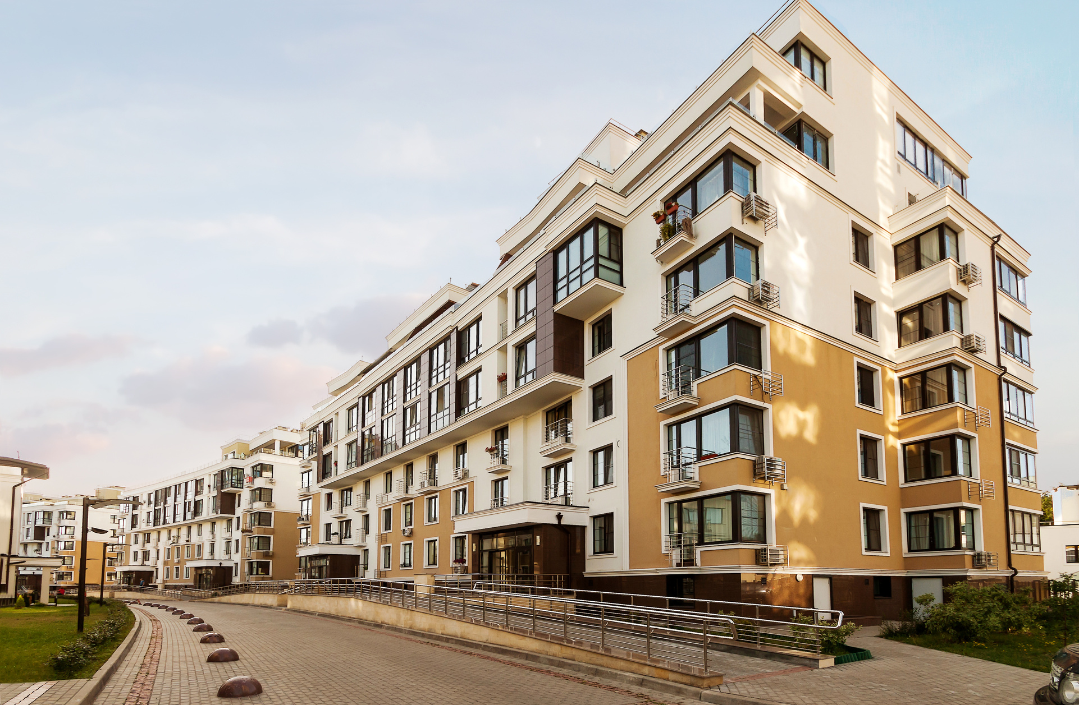
State Education Operating Tax Mills (SET)
EGLE Brownfield Grant and Loan (Traditional Eligible Activities)
MSHDA Housing Gap Assistance Financing (Housing and Infrastructure)
MEDC/MSF Brownfield Grant and Loan (Traditional Eligible Activities)

